Slide 1
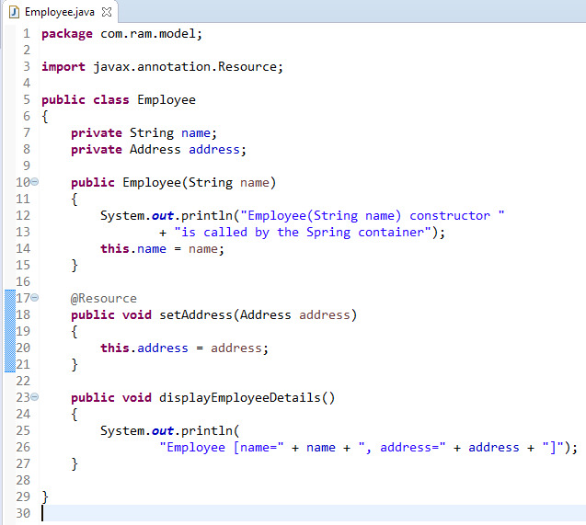
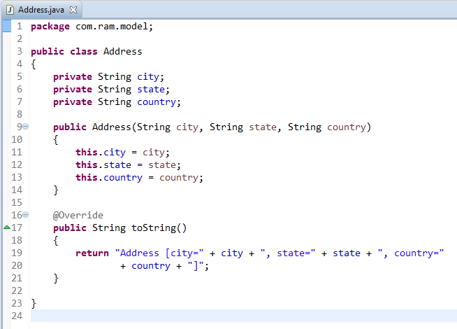
Spring Auto-Wiring Beans with @Resource annotation in Setter Method
The @Resource annotation is auto wire the bean by matching data type.
We can use @Resource annotation to auto wire bean on the setter method, constructor or a field. Moreover, it can autowired property in a particular bean. Here we have applied @Resource in setter method.

Slide 2
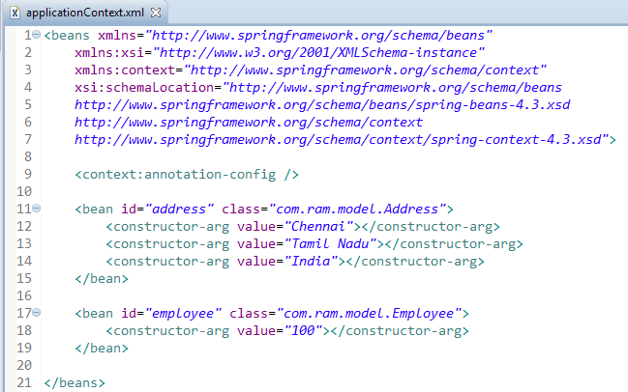
Spring Auto-Wiring Beans with @Resource annotation in Setter Method

Slide 3
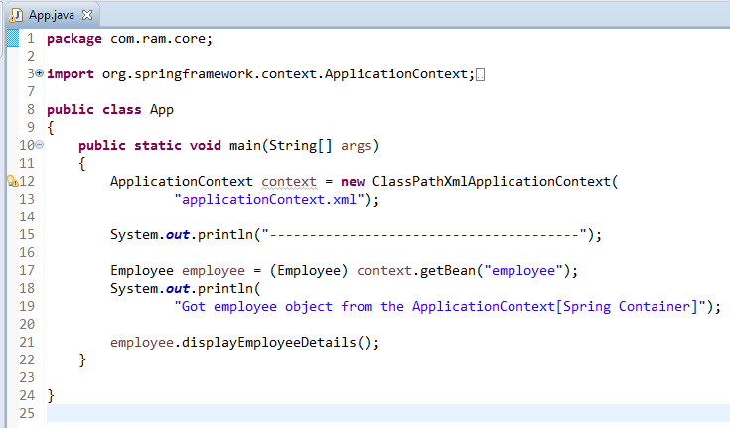
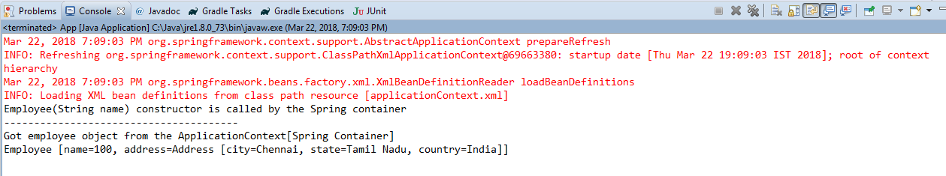
Spring Auto-Wiring Beans with @Resource annotation in Setter Method

